Slide 1



Mobile Testbeds with an Attitude
Sungwook Moon, Ahmed Helmy
{smoon, helmy}@cise.ufl.edu
http://nile.cise.ufl.edu
Thanks to all the NOMAD group members for their great helps
(U. Kumar, Y. Wang, G. Thakur, J. Kim and S. Mogahaddam)

Slide 2
Motivation
Evaluate mobile networks, their protocols and services in a realistic testing environment.
Examine performance of community based networking protocols [1][8][9] and mobility models [6][7] with realistic profiles
Bridge the gap between
  Controlled lab environment
  Random crowd sourcing by voluntary humans

Slide 3
Mobile testbeds proposal
We propose novel, mobile testbeds with two main components.
  The first consists of a network of robots with personality-mimicking, human-encounter behaviors, which will be the focus of this demo. The personality is build upon behavioral profiling of mobile users.
  The second integrates the testbed with the human society using participatory testing utilizing crowd sourcing.

Slide 4
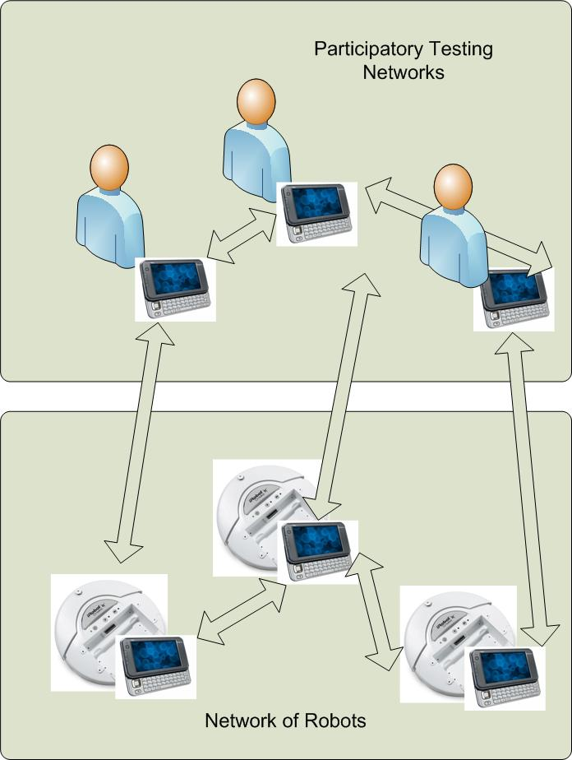
Testbeds design
Personality profile examples
Behavioral signature of location visiting preferences
Regular/irregular/random Contact patterns with other mobile nodes
Attraction to friendly community and repulsion to unfriendly community
Embed profile to robots

Slide 5
Communication structure

Slide 6
Advantages of embedded personality on robots
Bridge the gap between controlled testbeds (fixed mobility) and uncontrolled testbeds (crowd sourcing) by using personality profiles on the robots.
Realistic testing environment for social/community/profile based networking protocols. [1][8][9]
Scalable testbed through participatory testing, achieved by using human society as a crowd sourcing.

Slide 7
Personality based on profile case #1
Behavioral signature produced by applying SVD (Singular Vector Decomposition) to the location visiting preference matrix
This behavioral signature can be used in similarity calculation between nodes for message transfer.
loc1 loc2 …………………. locN
day1 [ 0.5 ……………………….. 0.2 ]
day2 [ . 0.3 ……………… . ]
….. [ ……………………….. . ]
….. [ ……………………….. . ]
dayM [ 0.4 ……………………….. 0.1 ]

Slide 8
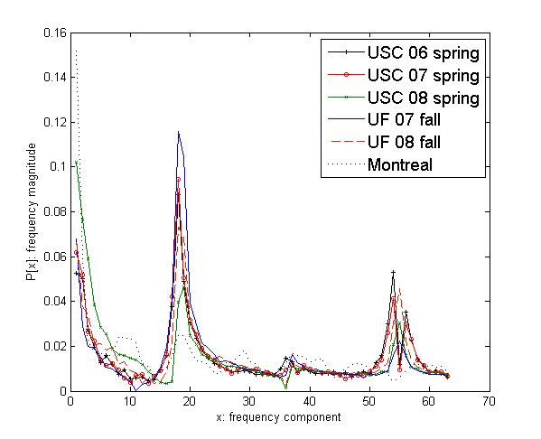
Personality based on profile case #2
Node has different periodic encounter pattern with different nodes.
Figure showing strong peak at frequency of 18 over 128 days indicates encounter pattern repeated in a weekly fashion. (18/128 = 7.xx) [5]

Slide 9
Personality based on profile case #3
Personalities have the following behavioral properties based on their encounter history. [7]
  Attraction: get closer to friends and friends community.
  Repulsion: get away from enemies.
  Draw: stay in current place.
Our demo presentation shows this personality on iRobot.
Accumulation of contact history takes long time; therefore, we hardcode profiles for demo purpose.

Slide 10
Demo implementation
Robot controller (Nokia N810) controls the movement of an iRobot via Bluetooth (virtual serial port) based on the information about nearby friends and enemies.
Identity of mobile devices is defined by MAC address of Bluetooth in each device.
Robot controller finds nearby friends and enemies by scanning Bluetooth devices.
Robot controller controls the speed, distance and turn angle of the iRobot based on its personality profile.
Friends or enemies can appear/disappear by turning on/off Bluetooth visibility of mobile devices they have instead of getting close/away in the demo environment

Slide 11
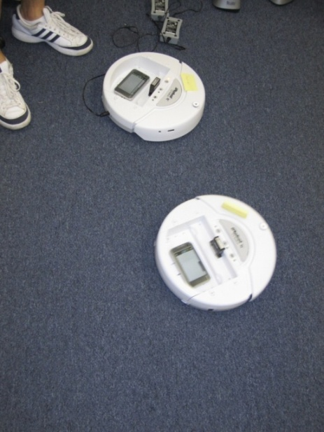
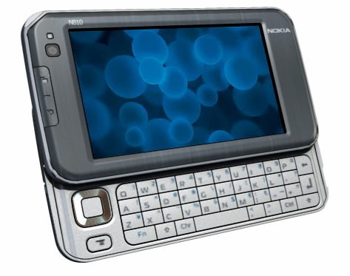
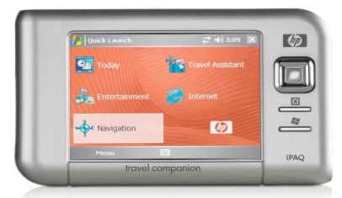
Devices used
iRobot Create w/ N810
Nokia N810
HP iPAQ

Slide 12
Demo scenario 1
Behavioral profile upon discovering friends/enemies
  No friends and enemies
    Search for friends.
    Turn by 90 degree and go forward fast.
  One friend
    Slow down as more friends may be in close proximity.
    Go forward slowly.
  Multiple friends
    Stay with friends community
    Stop
  Number of enemies > number of friends
    Move away from current location to avoid enemies
    Turn by 120 degree and go forward fast

Slide 13
State diagram
F: number of friends
E: number of enemies
Start
E ≥ 1
F=0 E=0
F=0, E=0
Search for friends
Run away
F=1, F ≥ E
F = 1
F = 0
F < E
F ≥ E
F < E
Slow down
Stop
F = 1, F ≥ E
F > 1

Slide 14
Demo scenario 2
Rules are the same as scenario 1.
There are two teams
  Team Blue
    Nokia N810 controlling the iRobot Blue
    HP iPAQ & Nokia N810s with Team Blue marks
  Team Red
    Nokia N810 controlling the iRobot Red
    Nokia N810s and N800s with Team Red marks
Same team members are friends among them.
Other team members are enemies to each other.

Slide 15
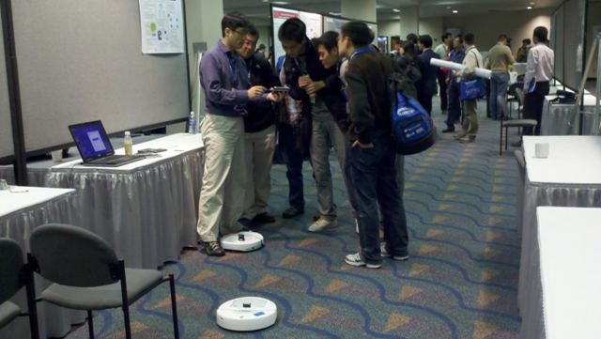
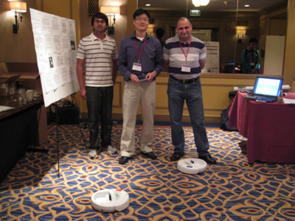
Mobile Testbed with an Attitude
Two main components of this testbed.
  The first consists of a network of robots with personality-mimicking, human-encounter behaviors. The personality is build upon behavioral profiling of mobile users.
  The second integrates the testbed with the human society using participatory testing utilizing crowd sourcing.
IEEE GlobeCom, Dec 2010
WINTECH, ACM MobiCom, Sep 2010
* Runner-up, Best Demo Competition

Slide 16
References
W. Hsu, D. Dutta and A. Helmy, “Profile-Cast: Behavior-Aware Mobile Networking”, WCNC 2008.
P. De, A. Raniwala, S. Sharma and T. Chiueh, “MiNT: A Miniaturized Network Testbed for Mobile Wireless Network”, IEEE INFOCOM 2005.
J. Reich, V. Mishra and D. Rubenstein, “Roomba MADNeT: A Mobile Ad-hoc Delay Tolerant Network Testbed”, ACM MCCR, Jan 2008.
B. Walker, I. Vo, M. Beecher and M. Seligman, “A Demonstration of the MeshTest Wireless Testbed for DTN Research”, CHANTS workshop in ACM MobiCom, 2008.
S. Moon and A. Helmy, “Understanding Periodicity and Regularity of Nodal Encounters in Mobile Networks: A Spectral Analysis”, accepted for IEEE GlobeCom, Dec 2010.
W. Hsu, T. Spyropoulos, K. Psounis and A. Helmy, “Modeling Spatial and Temporal Dependencies of User Mobility in Wireless Mobile Networks”, IEEE/ACM Trans. on Networking, Vol. 17, No. 5, Oct 2009.
J. Whitbeck, M. Amorim and Vania Conan, “Plausible mobility: inferring movement from contact”, MobiOpp Feb 2010.
P. Hui, J. Crowcroft and Eiko Yoneki, ”Bubble rap: social-based forwarding in delay tolerant networks”, MobiHoc, 2008
E. M. Daly, M. Haahr, “Social network analysis for routing in disconnected delay-tolerant MANETs”, MobiHoc 2007.
S. Moon and A. Helmy, “Mobile Testbeds with an Attitude”, technical report, arXiv:1009.3567

